Slide 1
21AIE304 Big Data and Database Management System PROJECT
By
Team-06

Slide 2
TEAM 6
01
Rachure Charith Sai
02
Menta Sai Akshay
CB.EN.U4AIE20055
CB.EN.U4AIE20040
03
Sajja Bala Karthikeya
04
D Rohith
CB.EN.U4AIE20065
CB.EN.U4AIE20060
05
Penaka Vishnu Reddy
CB.EN.U4AIE20048

Slide 3
Covid 19 Analysis and Prediction

Slide 4
Data Description
Coronaviruses are a large family of viruses which may cause illness in animals or humans. In humans, several coronaviruses are known to cause respiratory infections ranging from the common cold to more severe diseases such as Middle East Respiratory Syndrome (MERS) and Severe Acute Respiratory Syndrome (SARS).
The number of new cases is increasing day by day around the world. This dataset has information from the states and union territories of India.
Attribute Information
State/UTs - Names of Indian States and Union Territories.
Total Cases - Total number of confirmed cases
Active - Total number of active cases
Discharged - Total number of discharged cases
Deaths - Total number of deaths
Active Ratio (%) - Ratio of number of active cases to total cases
Discharge Ratio (%) - Ratio of number of discharged cases to total cases
Death Ratio (%) - Ratio of number of deaths to total cases
https://www.kaggle.com/code/imakash3011/covid-19-india-eda-visualization-report/data

Slide 5
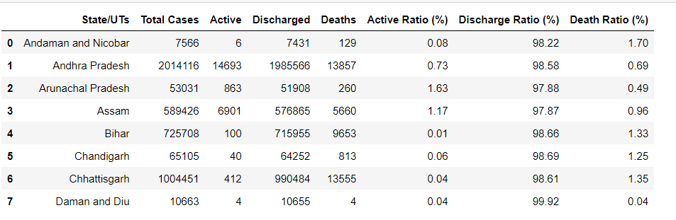
Data

Slide 6
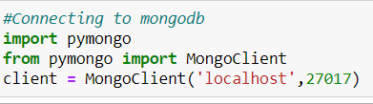
Connecting Mongodb Database with Python
To establish a connection to a database, we need to create a Mongo Client instance. This class provides a client for a MongoDB instance or server. Each client object has a built-in connection pool, which by default handles up to a hundred connections to the server.
The code above establishes a connection to the default host (localhost) and port (27017). Mongo Client takes a set of arguments that allows us to specify custom host, port, and other connection parameters.

Slide 7
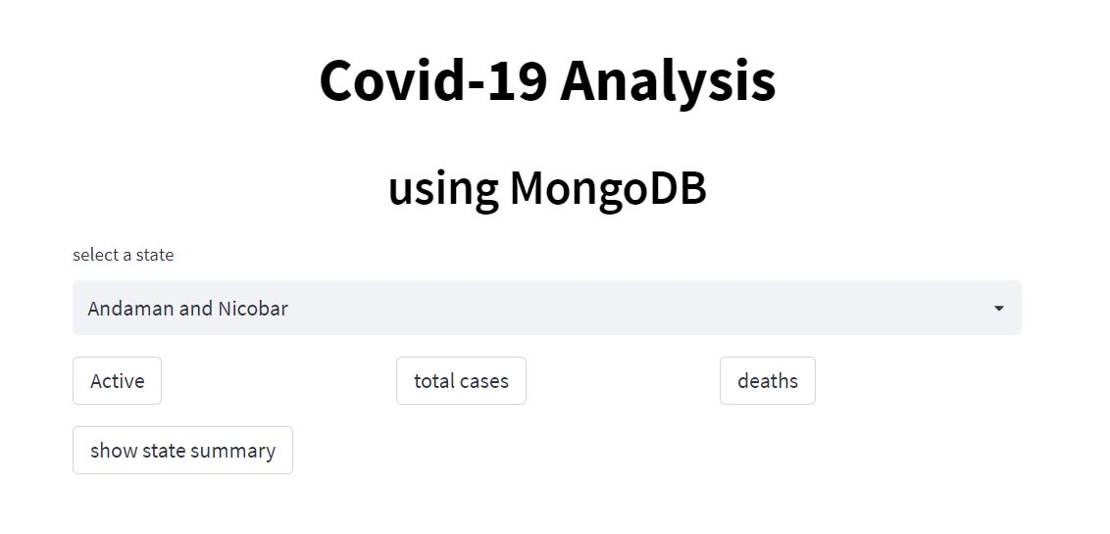
Web Interface

Slide 8
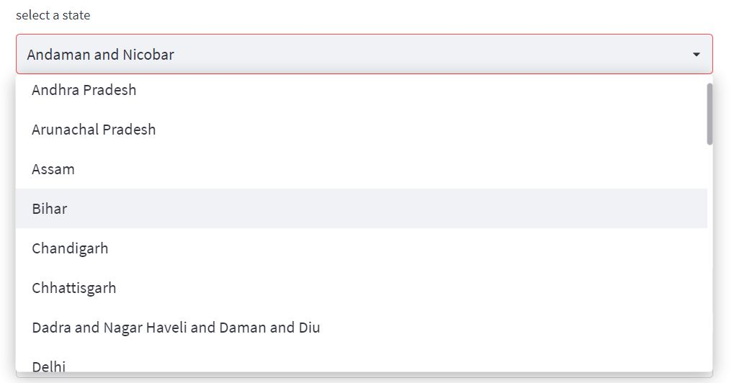
Selecting State

Slide 9
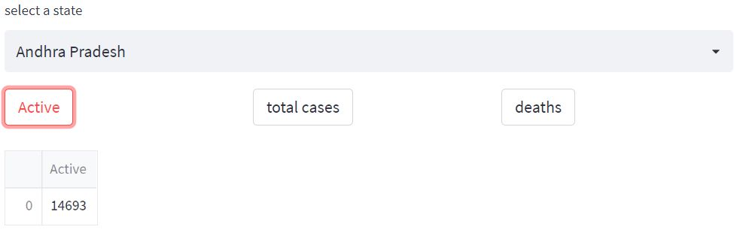
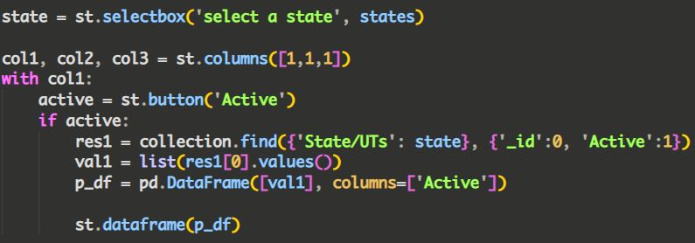
Active Cases in a State

Slide 10
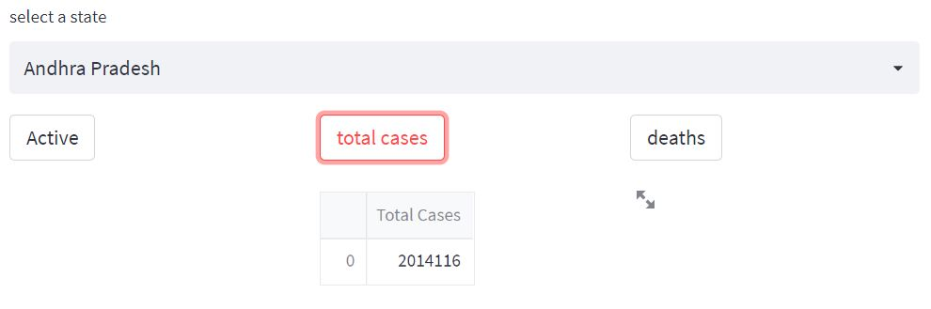
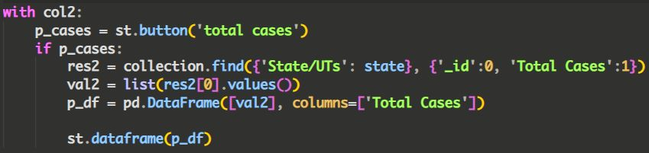
Total Cases in a State

Slide 11
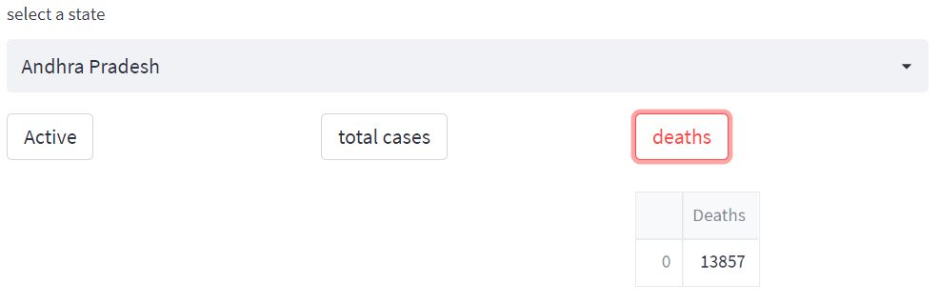
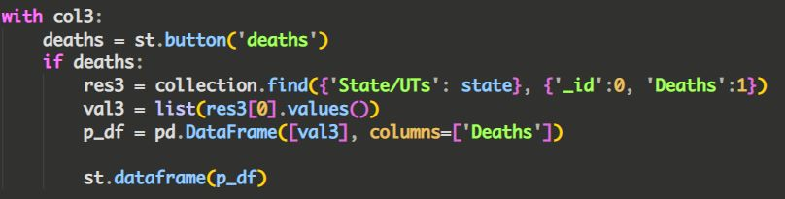
Total Deaths in a State

Slide 12
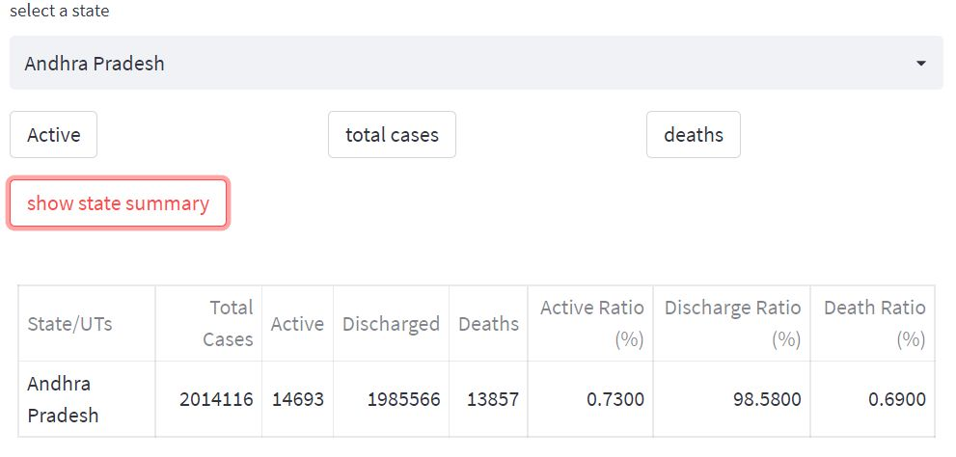
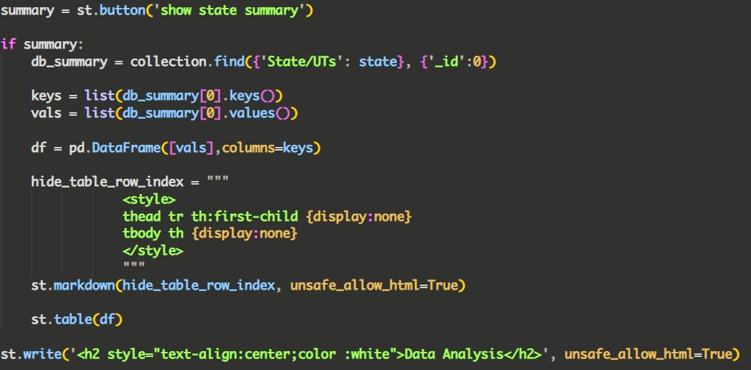
State Summary

Slide 13
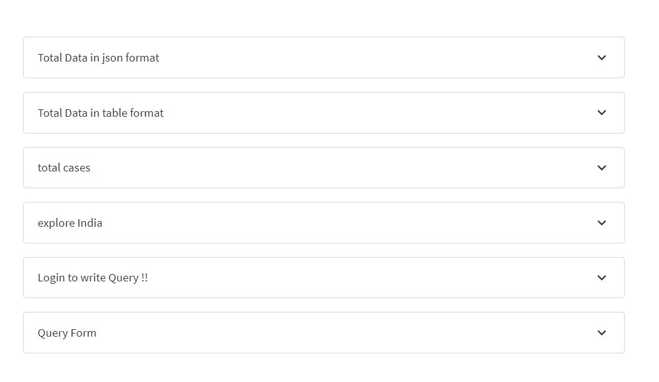
COVID Data Querying and Plots

Slide 14
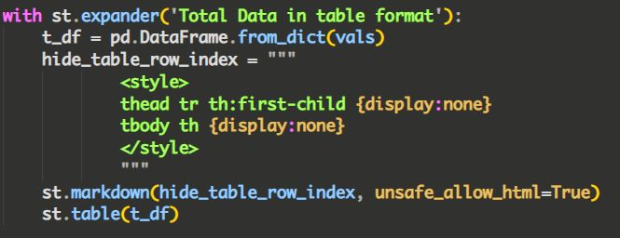
Query for Extracting COVID Data in a Tabular Form

Slide 15
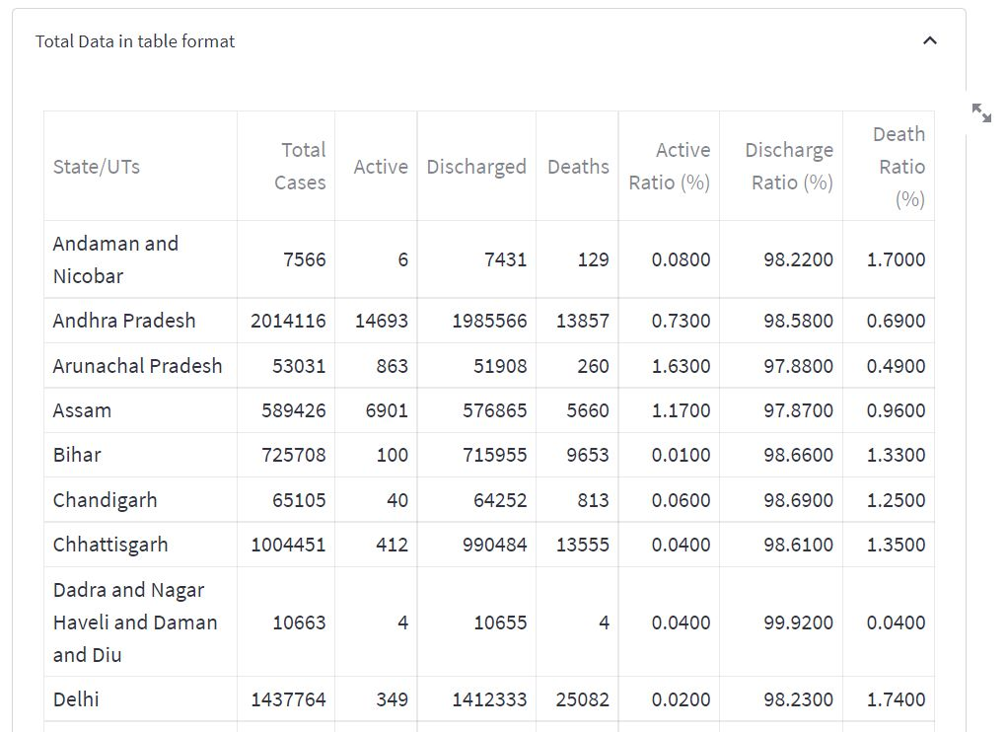
COVID Data in a Tabular Form

Slide 16
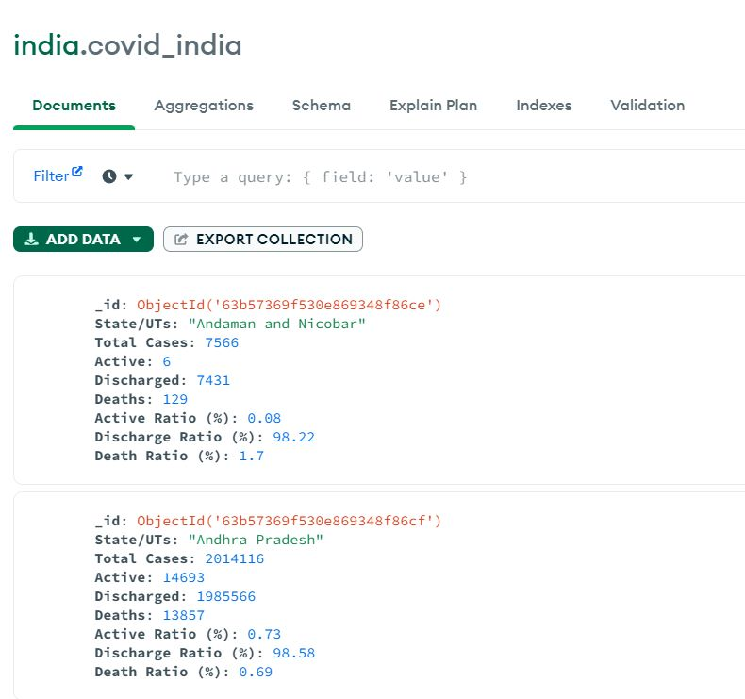
COVID Data in Mongo Compass

Slide 17
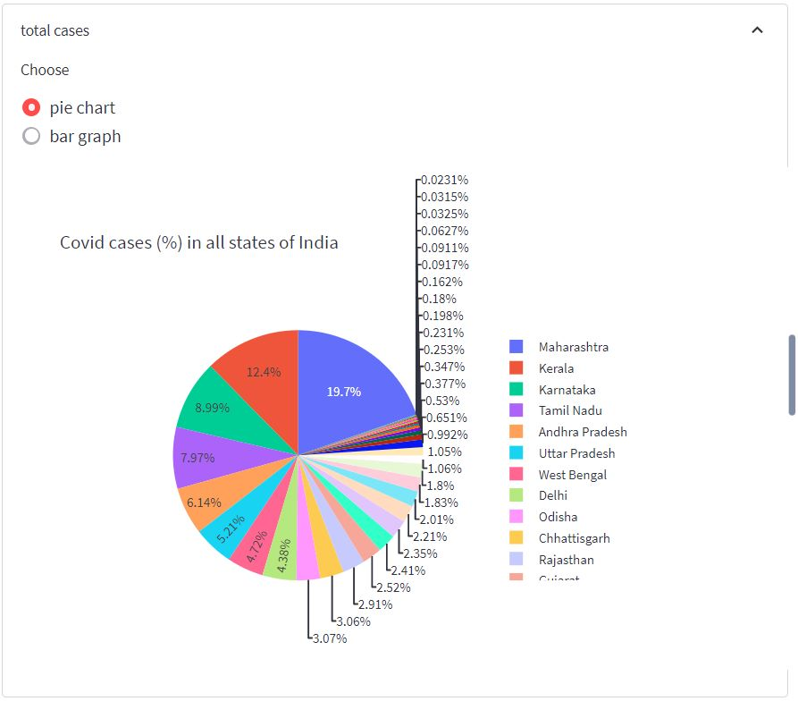
Total Covid Cases in India

Slide 18
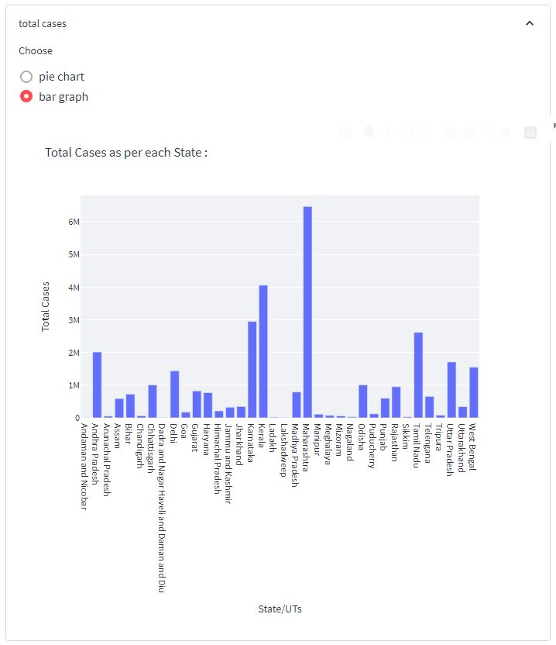
Total Covid Cases in India

Slide 19
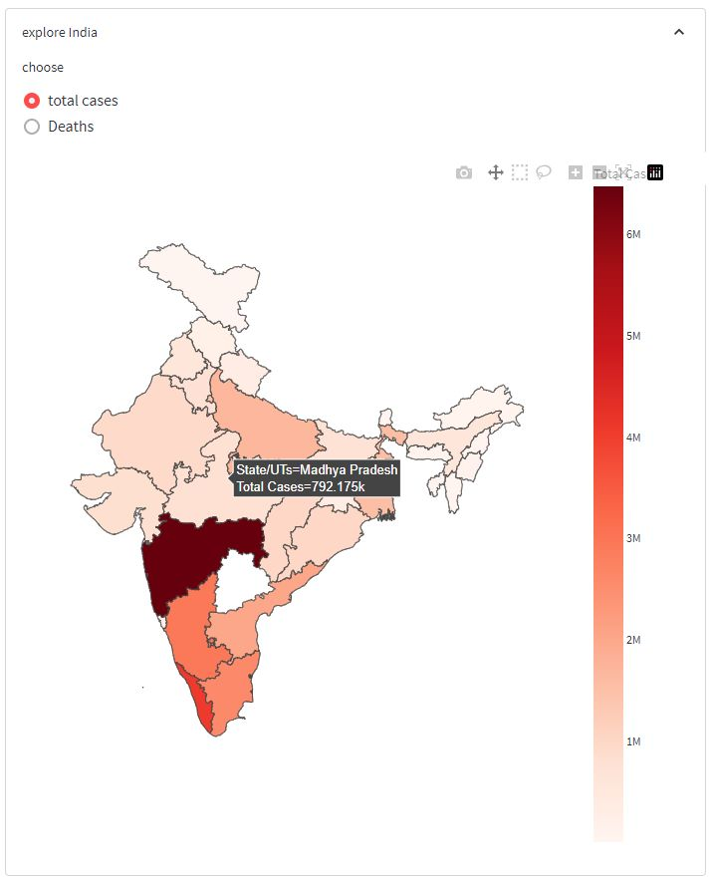
Geographical Representation of total cases

Slide 20
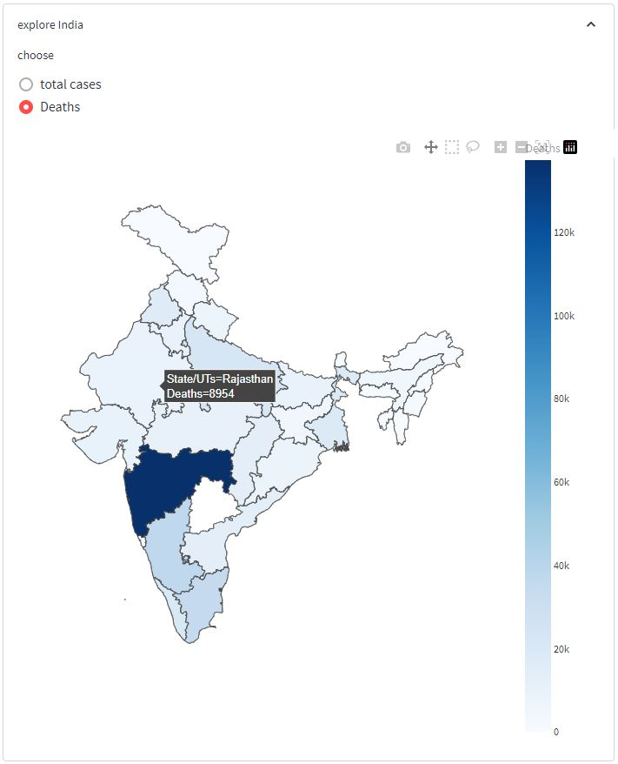
Geographical Representation of total Deaths

Slide 21
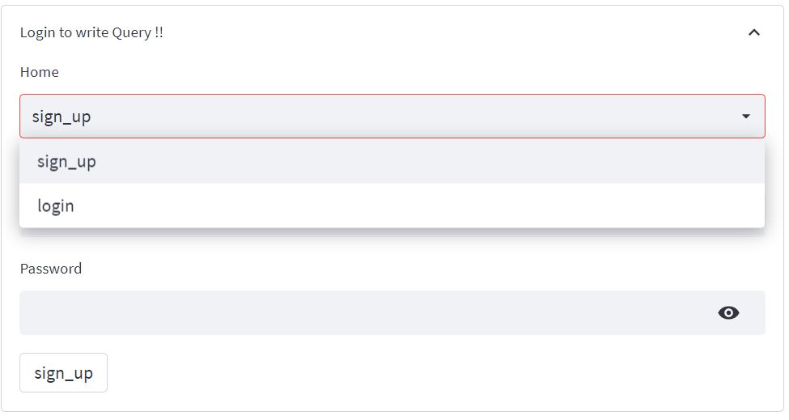
Sign Up Page for Querying

Slide 22
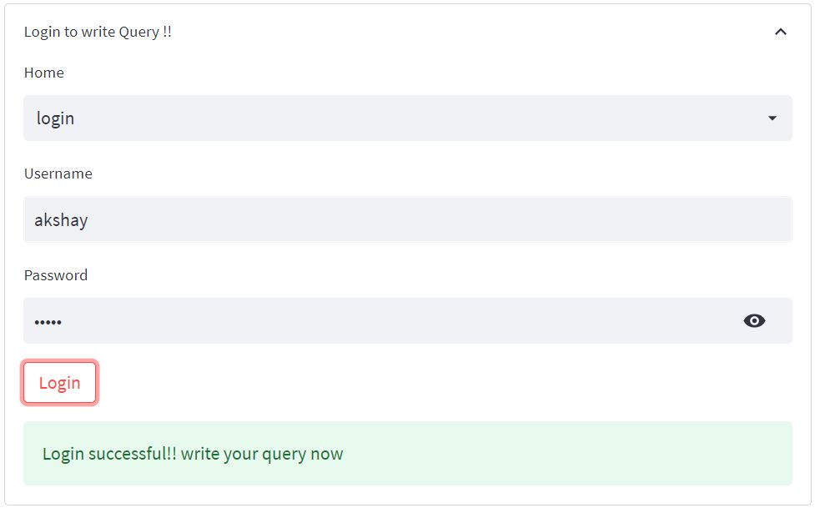
Login Page for Querying

Slide 23
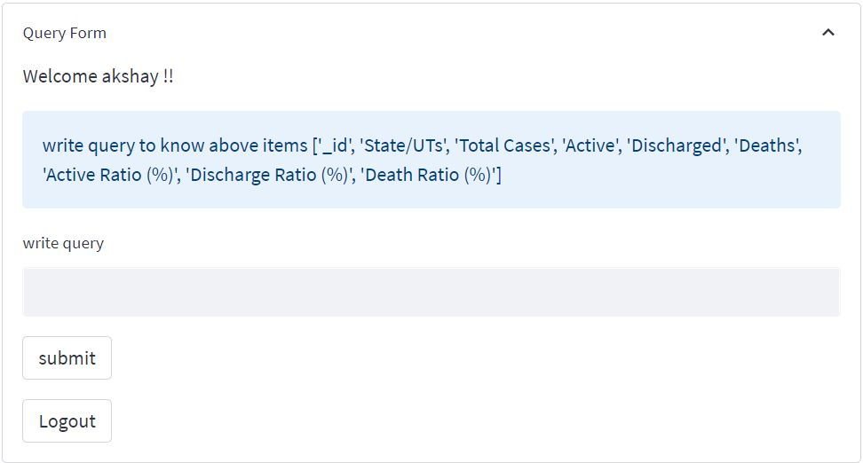
Query Form

Slide 24
Query Form

Slide 25
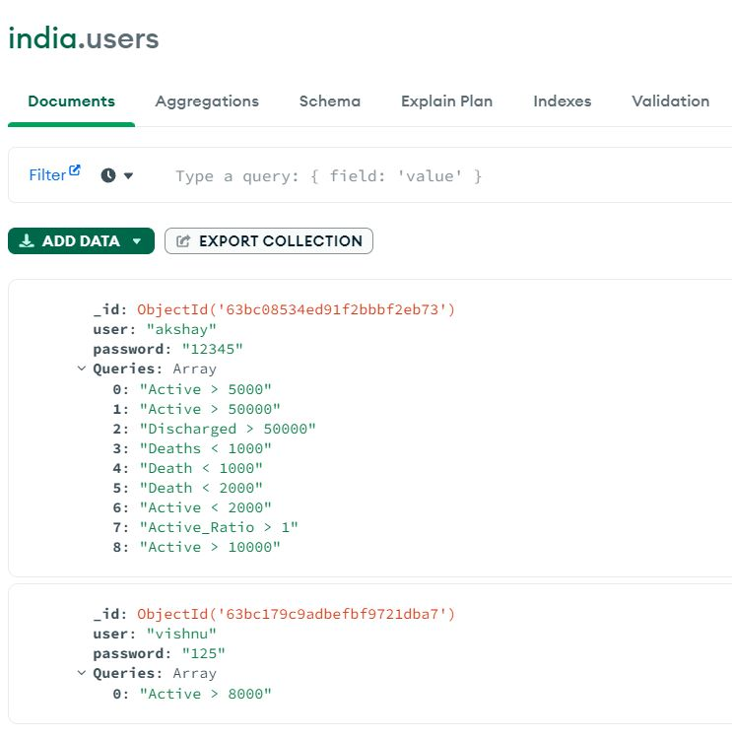
Dynamic Users Data

Slide 26
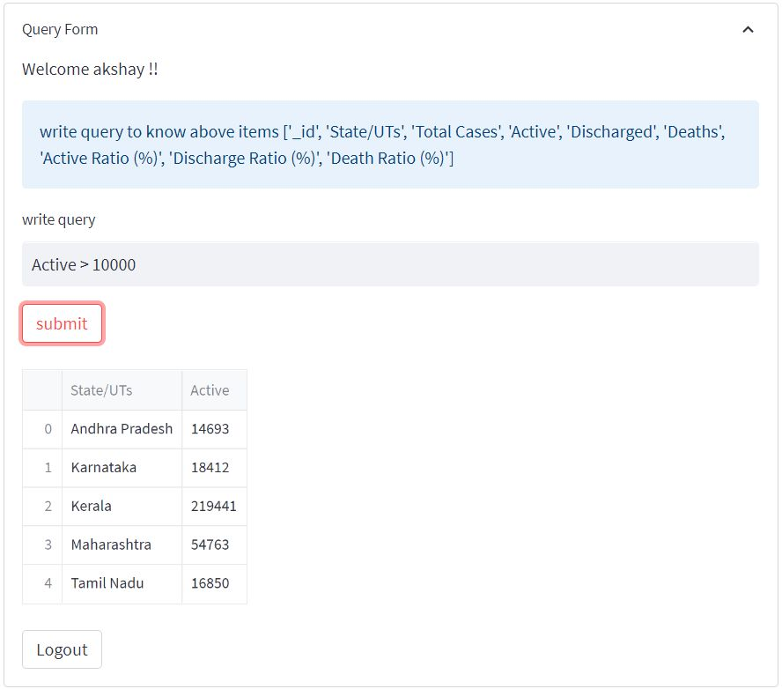
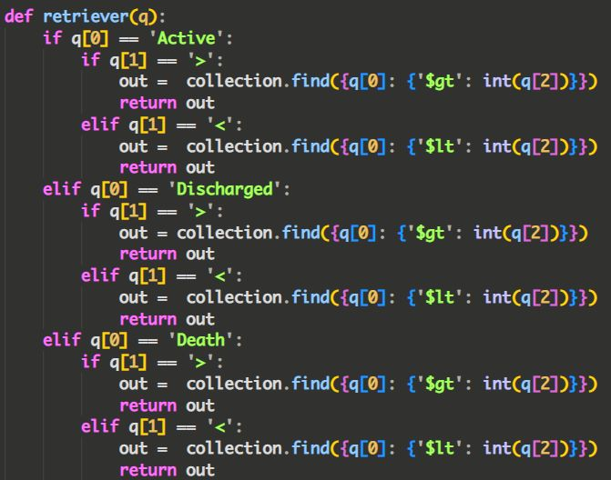
Query For Active Cases > 10000

Slide 27
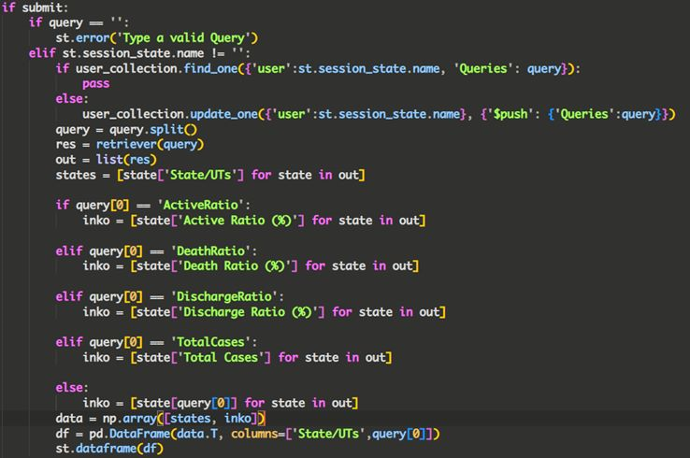

Slide 28
QUERYING COVID-19 GLOBAL AND US DATA USING AWS ATHENA AND REDSHIFT AND DYNAMODB
https://aws.amazon.com/blogs/big-data/a-public-data-lake-for-analysis-of-covid-19-data/
https://dj2taa9i652rf.cloudfront.net/ https://aws.amazon.com/covid-19-data-lake/

Slide 29
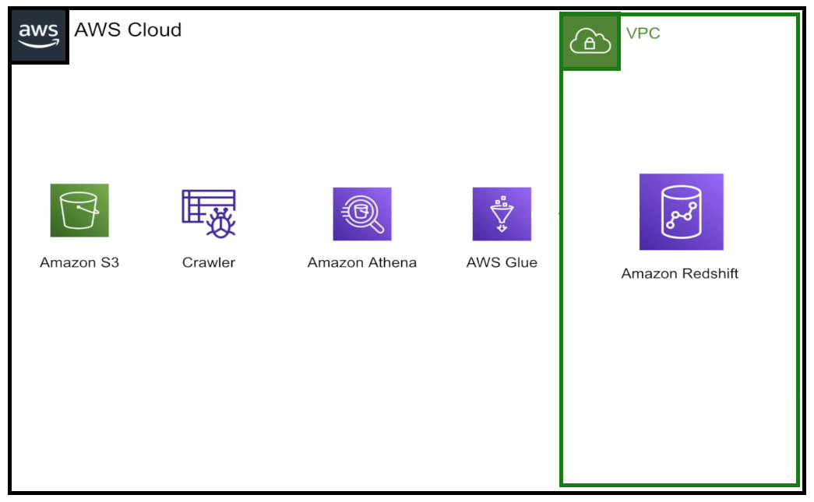



ARCHITECTURE DIAGRAM

Slide 30
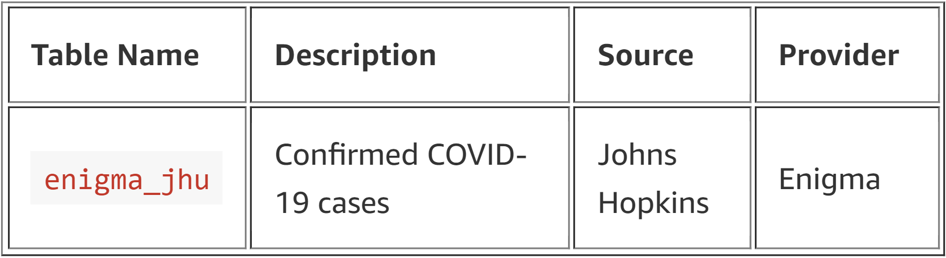
Exploring the data
Global Coronavirus (COVID-19) Data – Tracks confirmed COVID-19 cases in provinces, states, and countries across the world with a breakdown to the county level in the US.

Slide 31
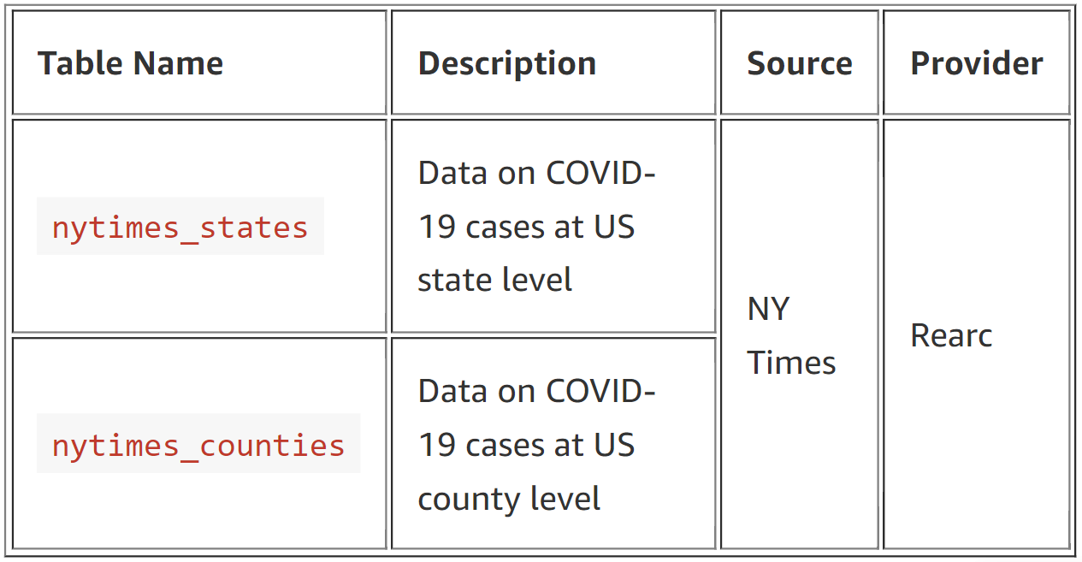
Coronavirus (COVID-19) Data in the United States – Tracks confirmed cases and deaths in the US by state and county.

Slide 32
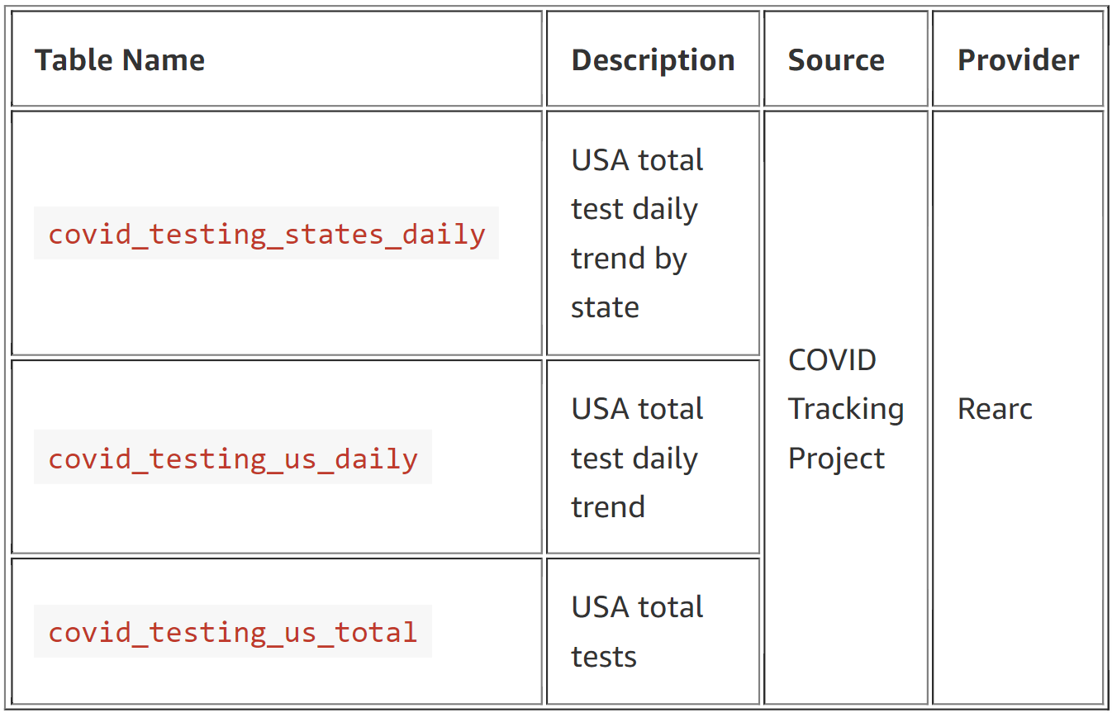
Coronavirus Disease (COVID-19) Testing Data – Tracks the number of people tested, pending tests, and positive and negative tests for COVID-19.

Slide 33
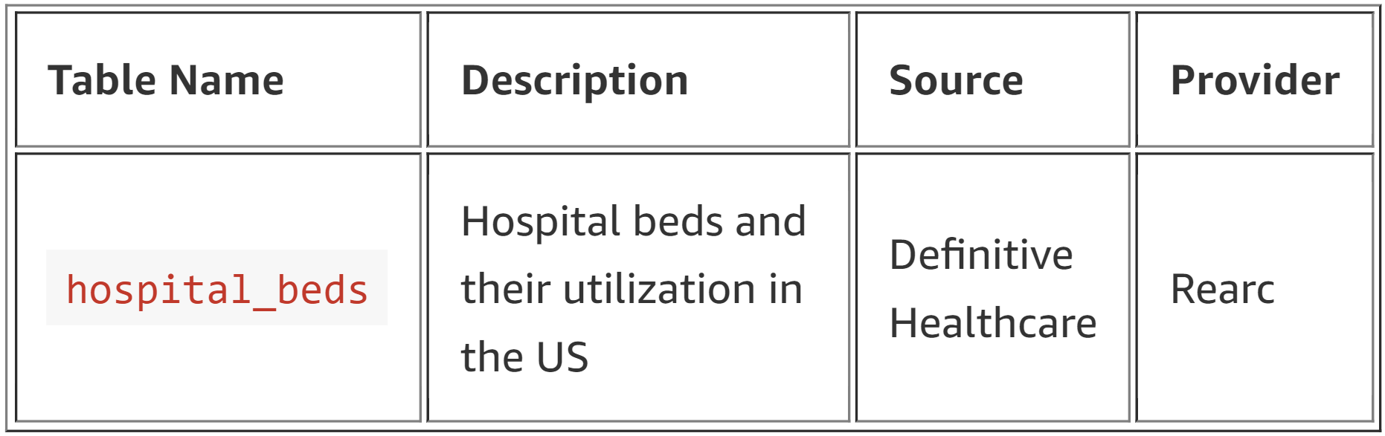
USA Hospital Beds – COVID-19 – Data on hospital beds and their utilization in the US.

Slide 34
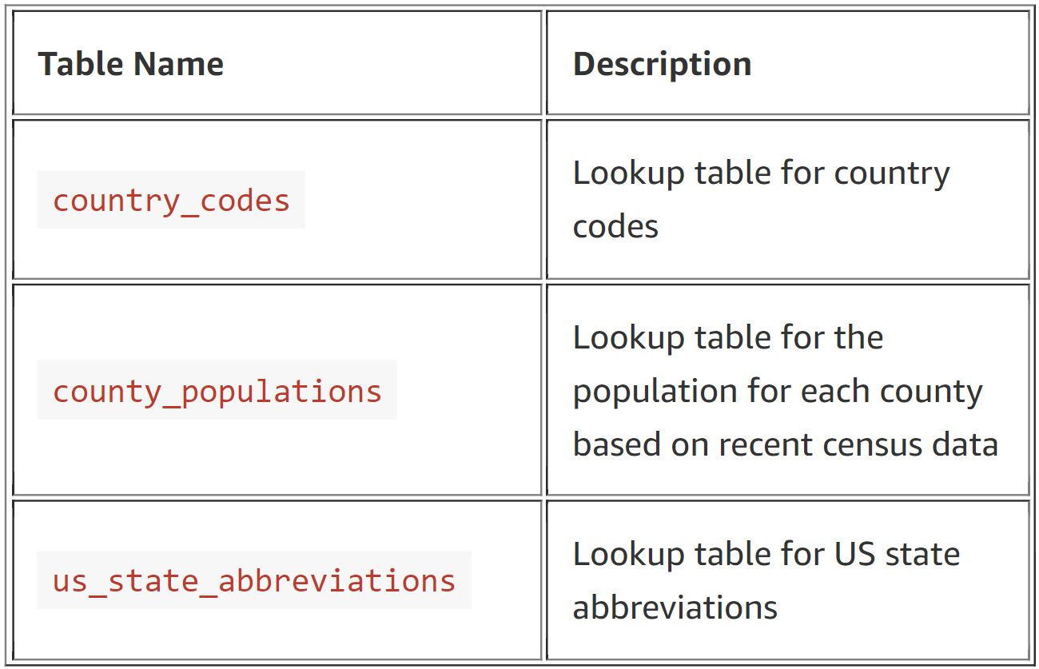
Lookup tables to support visualizations.

Slide 35
Methodology
Data model to our S3
Connect Athena and Query data
ETL job in python
Save results onto our S3
Glue Deployment
Build tables on RedShift and collections on DynamoDB
Copy data to RedShift and DynamoDB

Slide 36
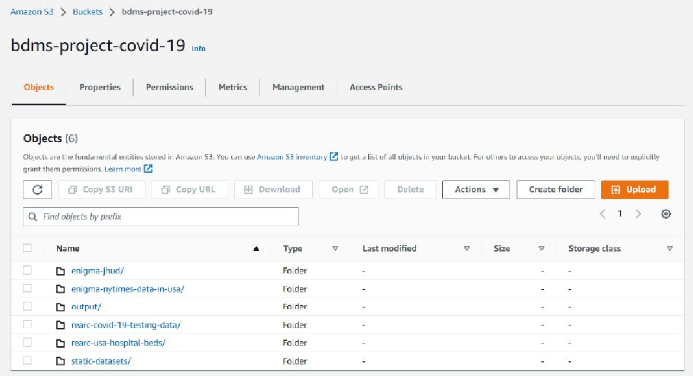
S3 Bucket

Slide 37
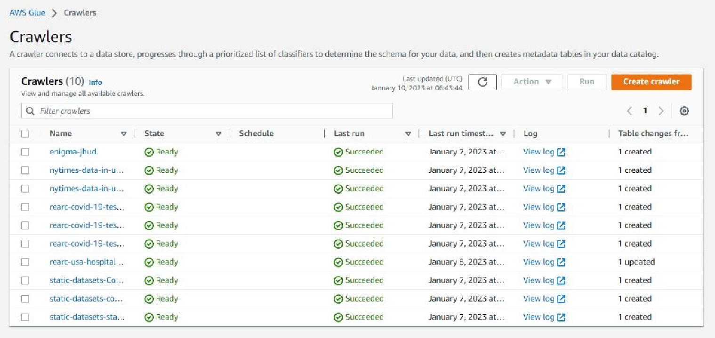
Crawler

Slide 38
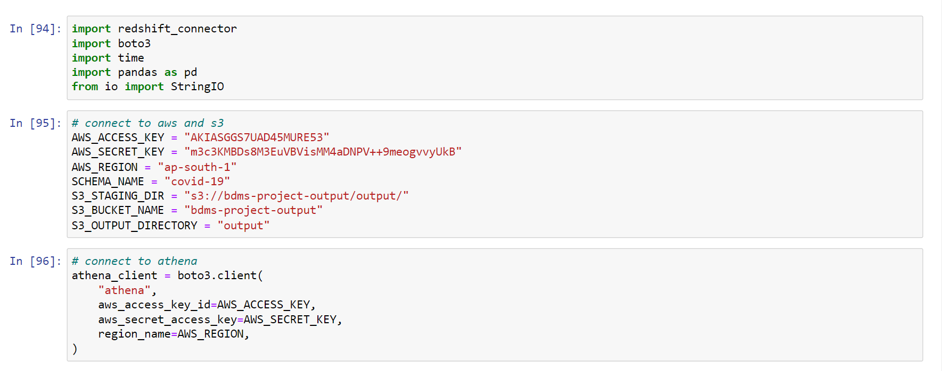
Connecting AWS services to Python using boto3

Slide 39
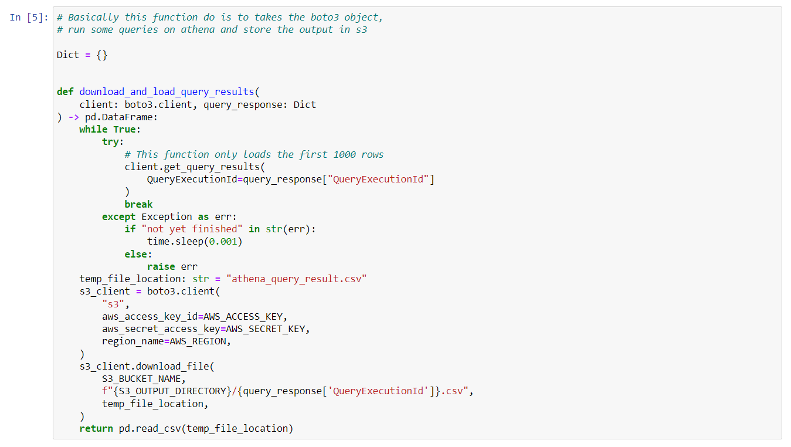

Slide 40
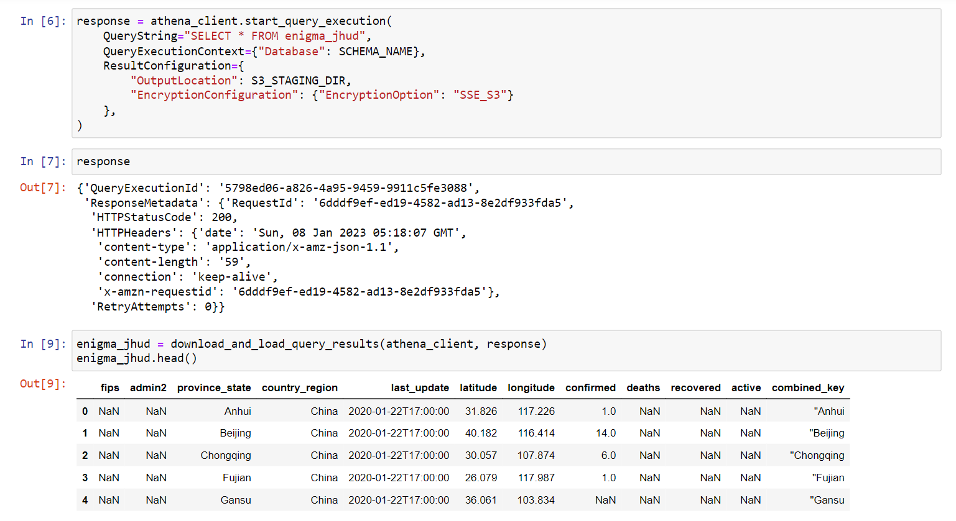

Slide 41
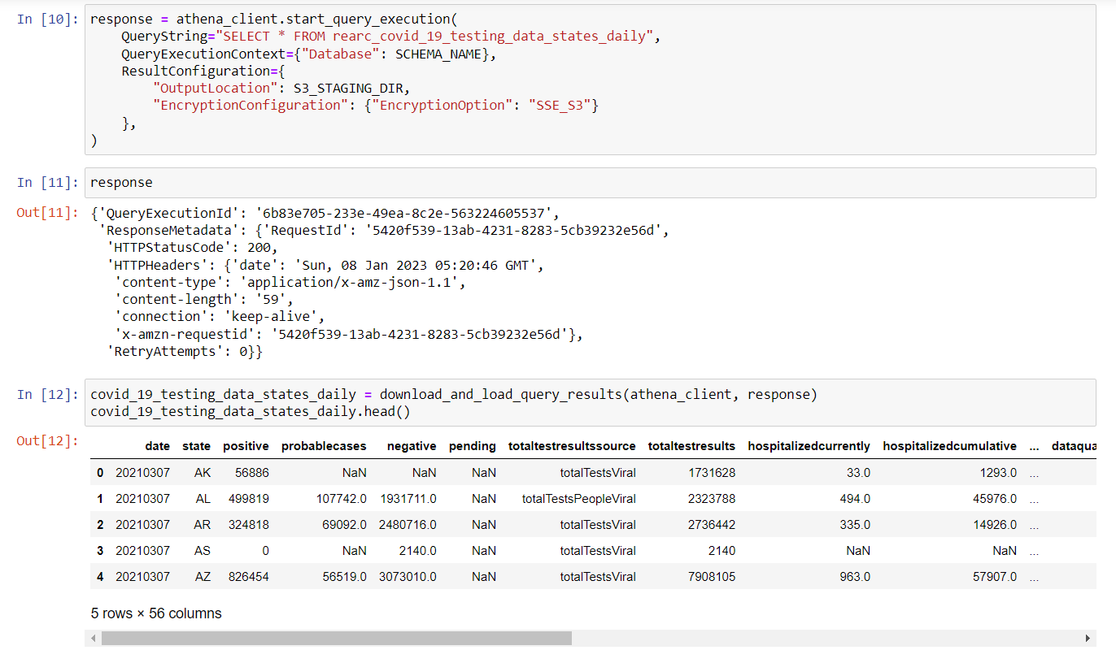

Slide 42
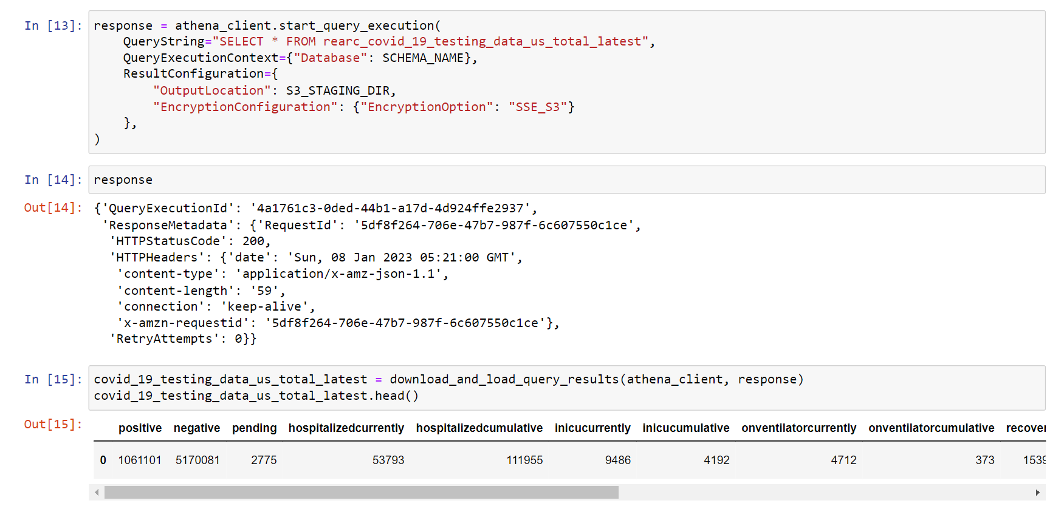

Slide 43
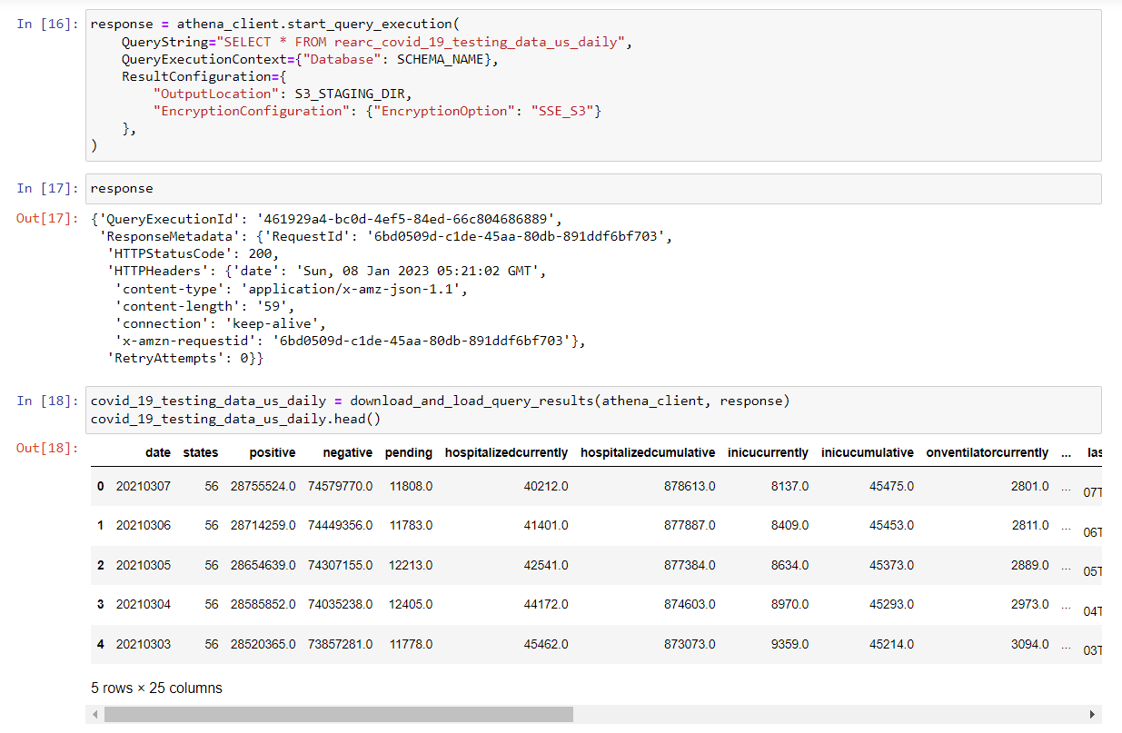

Slide 44
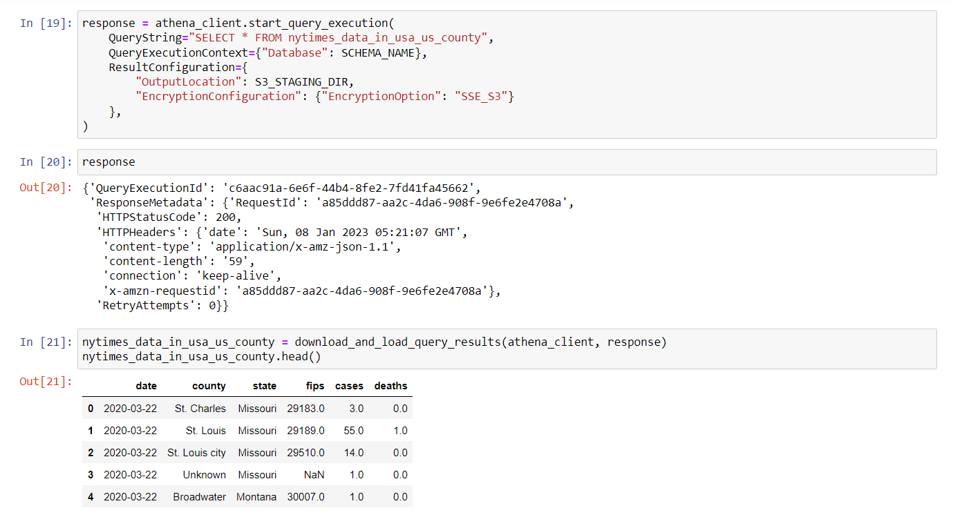

Slide 45
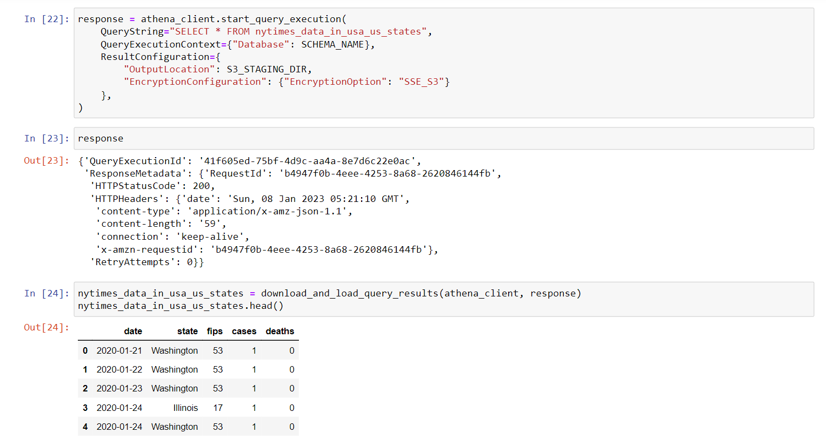

Slide 46
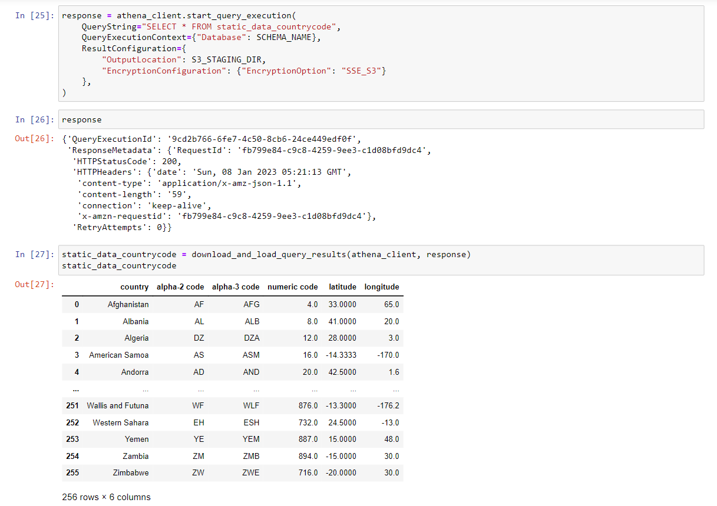

Slide 47
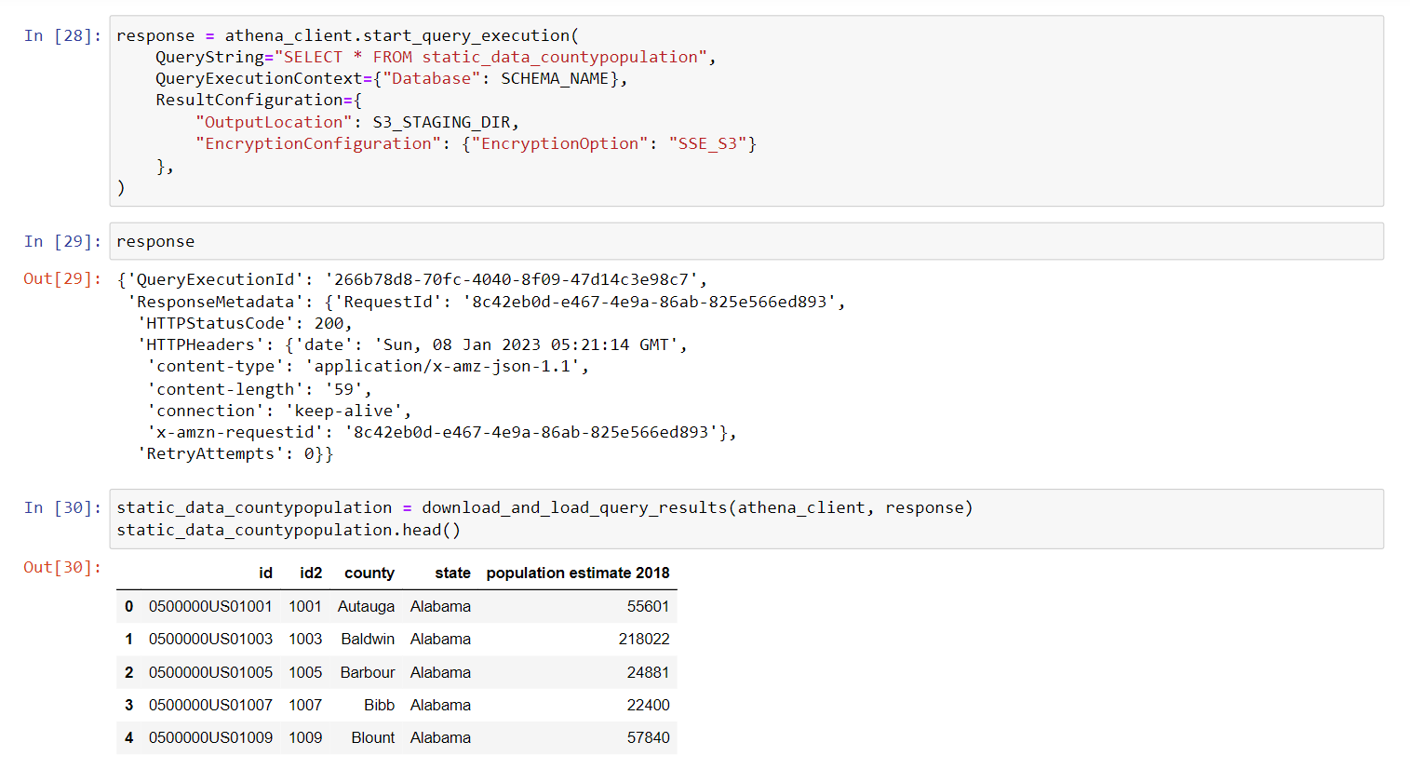

Slide 48
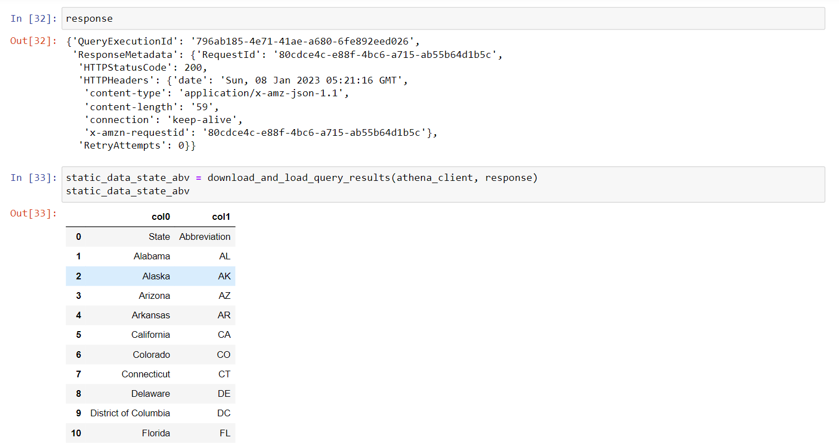

Slide 49
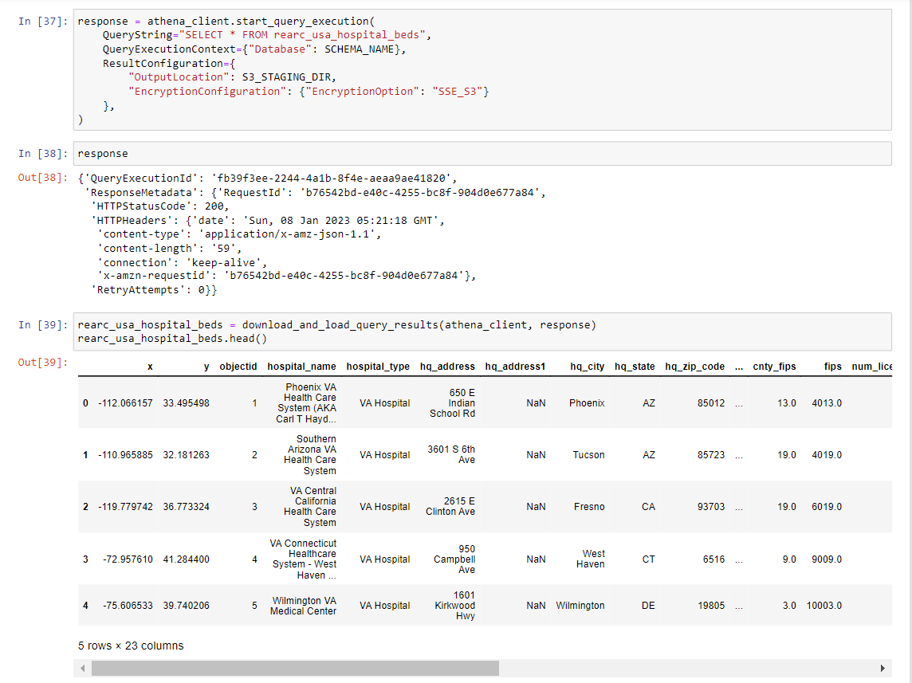

Slide 50
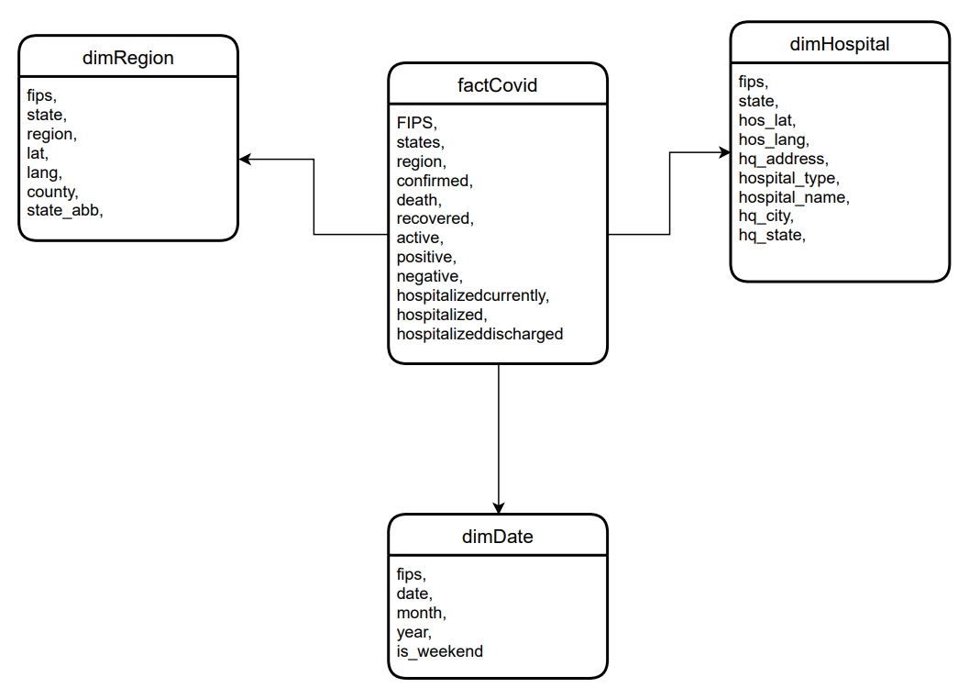
Dimension Model

Slide 51
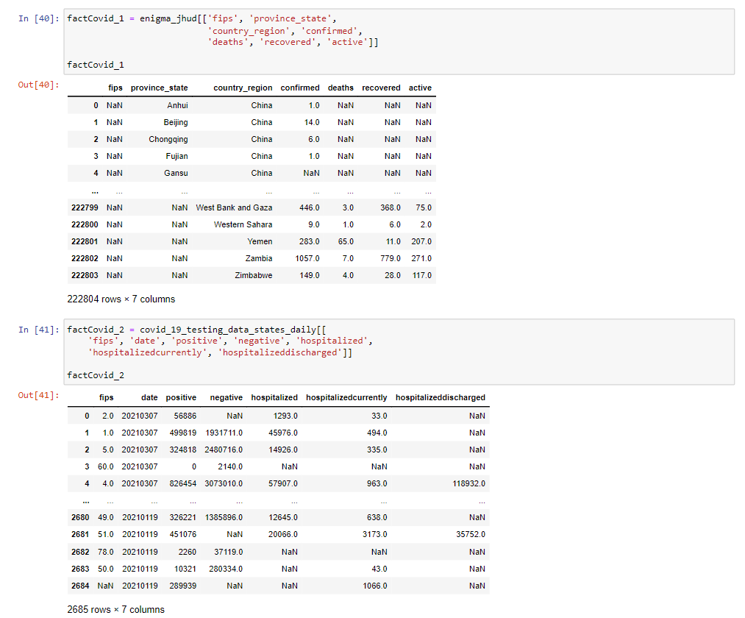

Slide 52
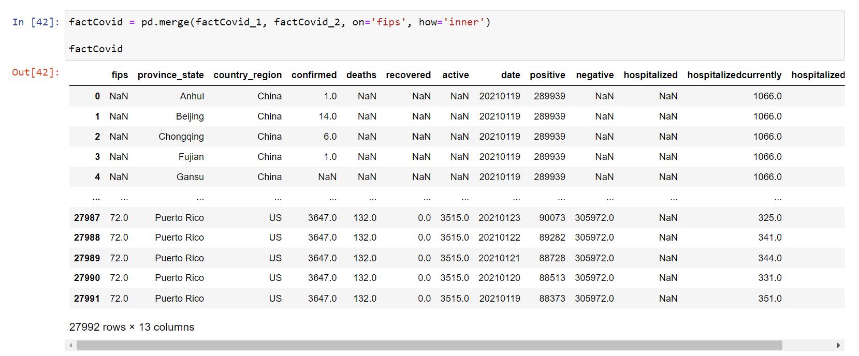

Slide 53


Slide 54


Slide 55


Slide 56

Athena

Slide 57

Glue

Slide 58


Slide 59


Slide 60


Slide 61


Slide 62


Slide 63


Slide 64


Slide 65


Slide 66

RedShift

Slide 67
Thank You

